Slide 1
Adversarial Attacks on Graph Embeddings Based on Text Dataset
Reporter: Fiona (Ying Xu)
Advisor: Prof. Yevgeniy (Eugene) Vorobeychik
Committee Member:
Prof. Nathan Jacobs
Prof. Ning Zhang
Date: 12/06/2023

Slide 2


Introduction
pictures from: https://bdtechtalks.com/2021/10/11/what-is-graph-neural-network/
https://www.vectorstock.com/royalty-free-vector/social-network-concept-vector-5669600

Slide 3
Introduction
What if?
We Attack the Graph!

Slide 4
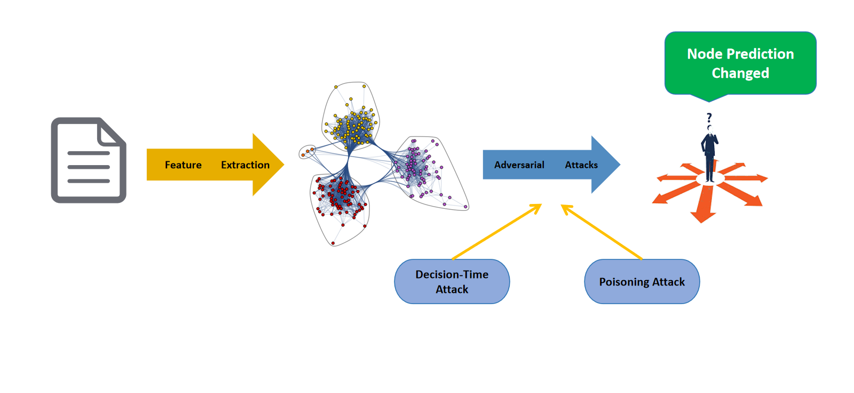
Motivation
Figure out the how the text embeddings change will influence the result of the groups in the social network & citation network.

Slide 5
Related Work & Prelimilaries
Machine Learning
Graph Neural Networks
Nature Language Processing
Adversarial Machine Learning

Slide 6
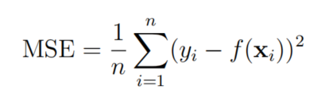
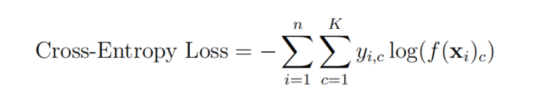
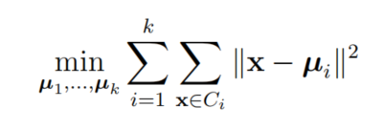

Machine Learning
Supervised Learning
Regression
Multi-class classification
Unsupervised Learning
Semi-supervised Learning
Differences: Labels ($y_{i}$)

Slide 7
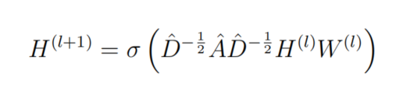
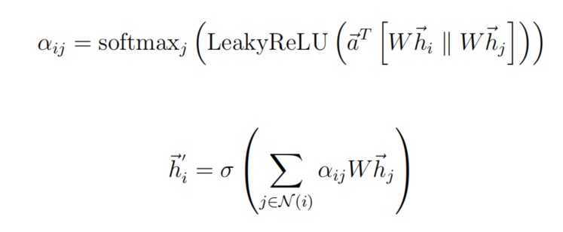
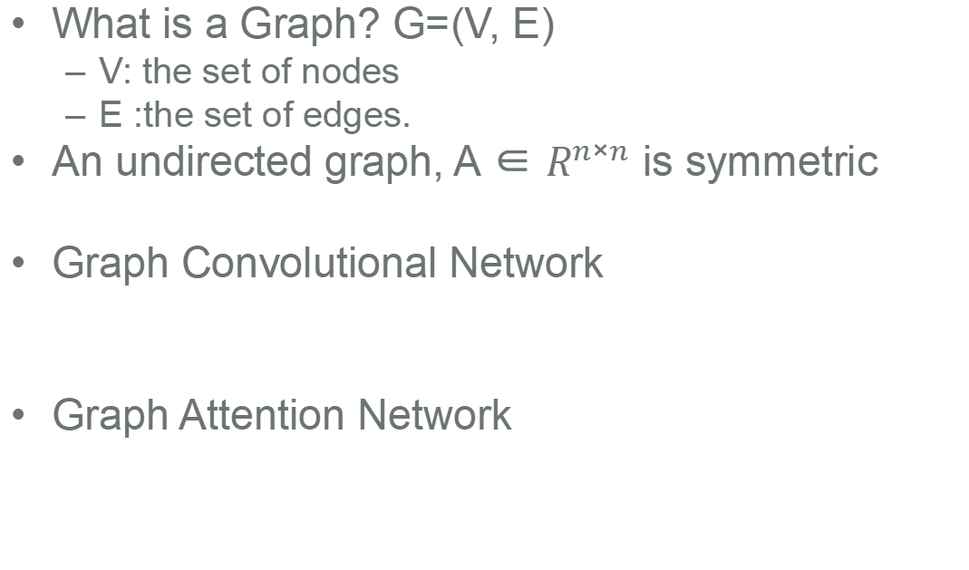
Graph Neural Network (GNNs)
What is a Graph? G=(V, E)
V: the set of nodes
E :the set of edges.
An undirected graph, A ∈ $R^{n×n}$ is symmetric
Graph Convolutional Network
Graph Attention Network

Slide 8
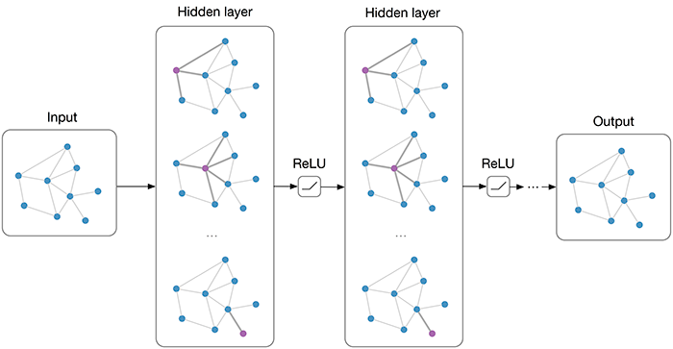
Graph Neural Network (GNNs)
Graph Convolutional Network (GCN)
Propogation function:

Slide 9
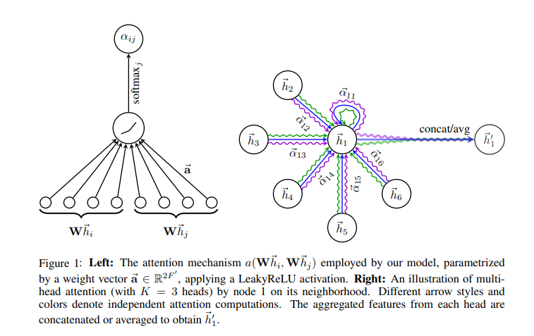
Graph Neural Network (GNNs)
Graph Attention Network

Slide 10
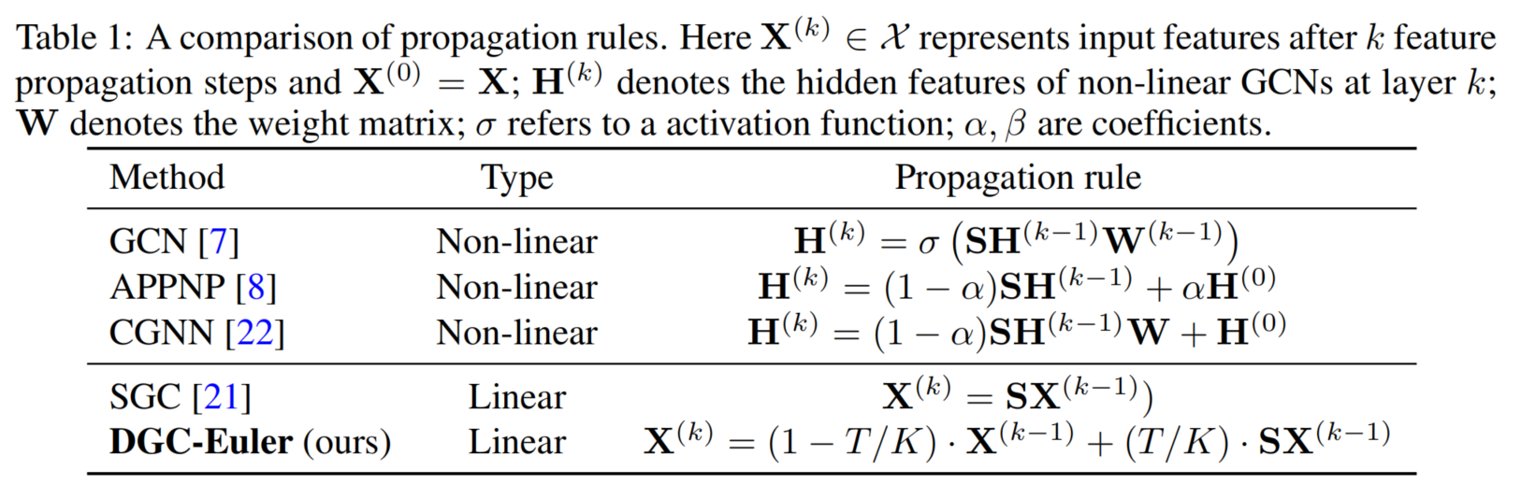
Graph Neural Network (GNNs)
There are actually more GNNs.
Paper link: https://zhouchenlin.github.io/Publications/2021-NIPS-Dissecting.pdf

Slide 11
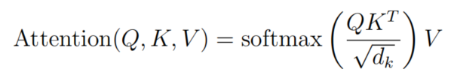
Natural Language Processing (NLP)
Natural Language Processing (NLP) has been propelled forward by the advent of models like BERT, and now LLM.
BERT’s fundamental mechanism relies on the Transformer architecture.
Pre-trained on a vast corpus of text, BERT captures deep language context through bidirectional training.
Q: Query
K: Key
V: Value

Slide 12

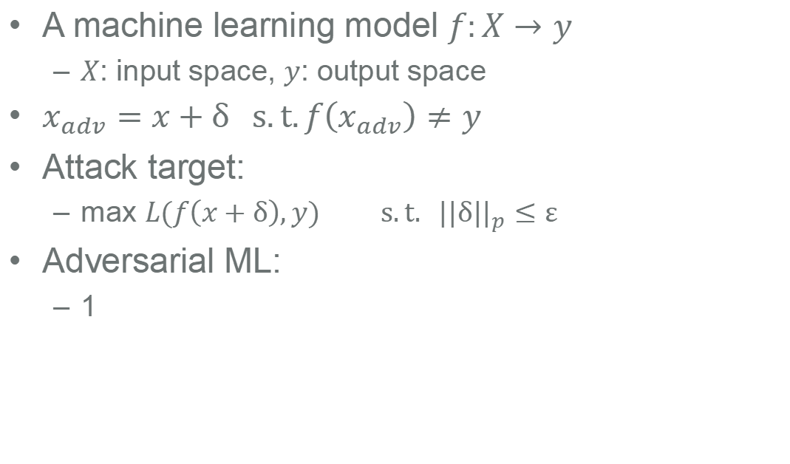
Adversarial Machine Learning
A machine learning model $f:X→y$
$X$: input space, $y$: output space
$x_{adv}=x+δ s.t.f\left(x_{adv}\right)≠y$
Attack target:
max $L(f\left(x+δ\right),y)$ $s.t. {||δ||}_{p}≤ε$
Adversarial ML:
1

Slide 13
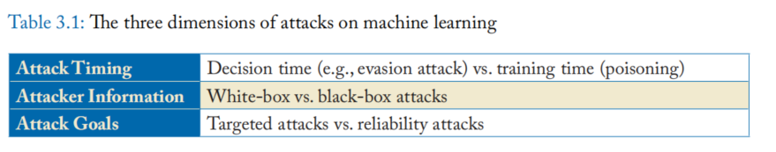
Adversarial Machine Learning
Three dimensions of attacks on ML
We will try both Decision-time Attack & Poisoning Attack
Table source: Adversarial Machine Learning (Yevgeniy Vorobeychik, Murat Kantarcioglu)

Slide 14
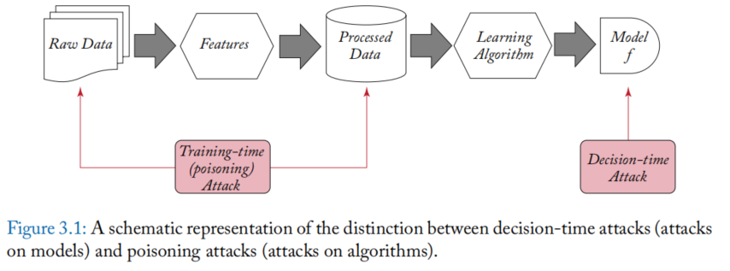
Adversarial Machine Learning
Decision-time Attack vs Poisoning Attack
Table source: Adversarial Machine Learning (Yevgeniy Vorobeychik, Murat Kantarcioglu)

Slide 15
Methodology
Experiment Workflow

Slide 16
Data Source
Text Dataset: Hellaswag
Graph Dataset: Cora, CiteSeer
Hellaswag: https://huggingface.co/datasets/Rowan/hellaswag
BERT
Node
Embeddings
Cosine similarity
Text
Graph

Slide 17
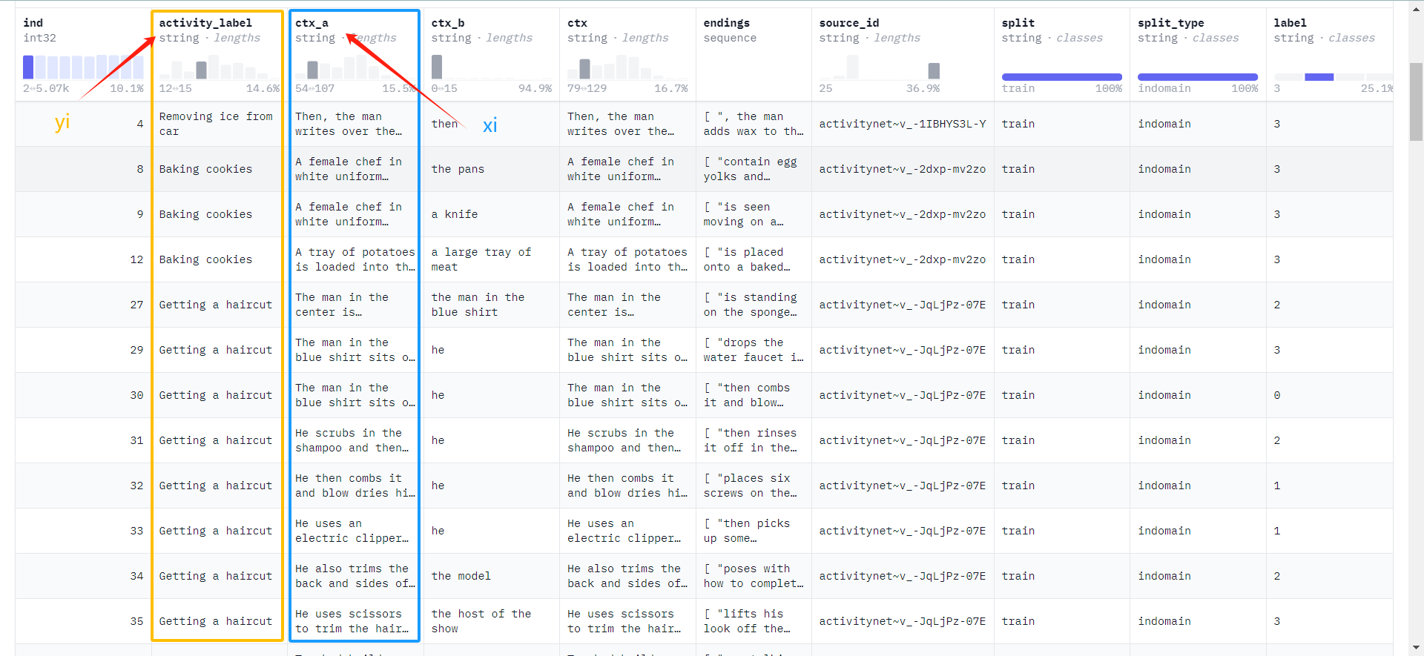
Hellaswag Data Overview

Slide 18


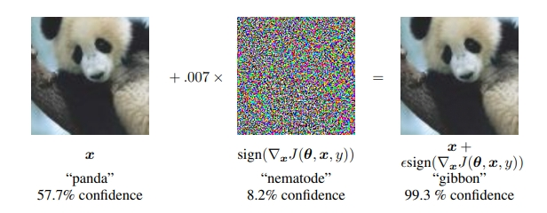
Decision-time Attack
FGSM:
PGD:
Weaker - One Step
Stronger
- Multi Steps
We choose to attack the whole graph using PGD, and also attack the Top-K degree nodes.

Slide 19
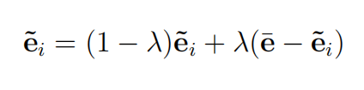

Poisoning Attack
Applying Gaussian Random Noises to Poison Node Embeddings
Deviating the Distribution of Node Embeddings
Applying Graph Contrastive Learning to Poison Node Embeddings

Slide 20
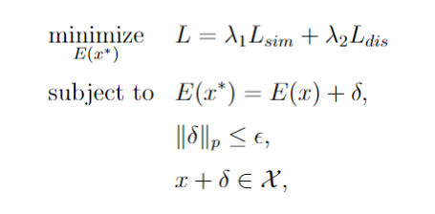
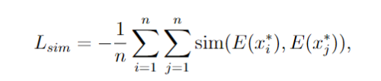
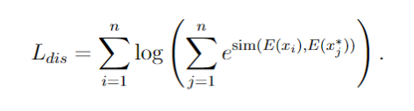
GCL Poisoning Attack

Slide 21
GCL Poisoning Attack
Turn multi-class classification To binary classification

Slide 22
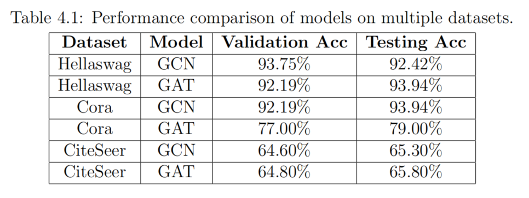
Experiment Settings & Results
Pure Dataset

Slide 23
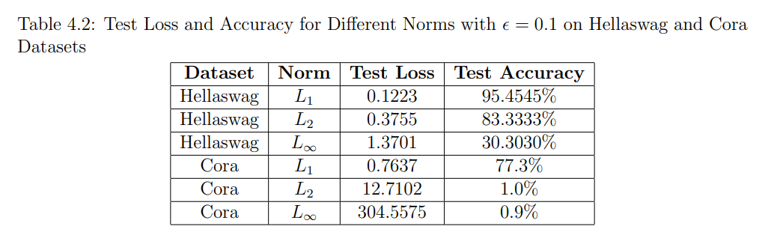
Experiment Settings & Results
PGD under Different Norms

Slide 24
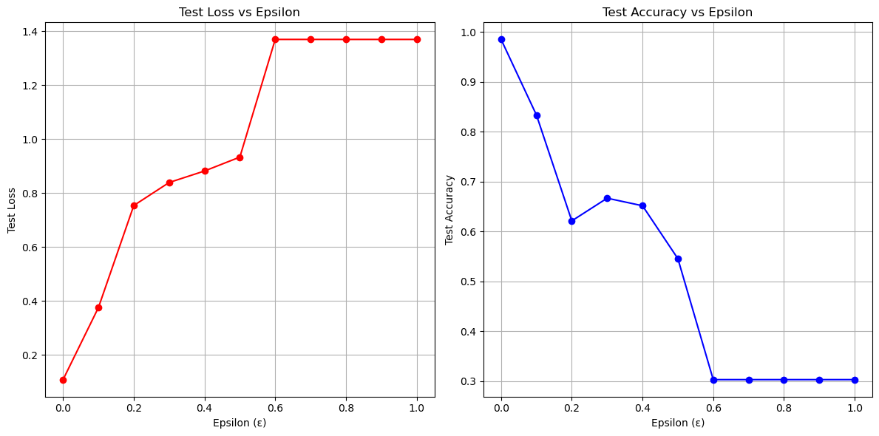
Experiment Settings & Results
epsilon PGD hellaswag result

Slide 25
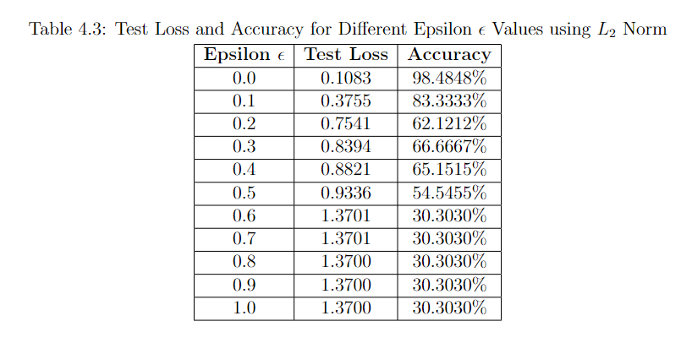
Experiment Settings & Results
epsilon PGD hellaswag result

Slide 26
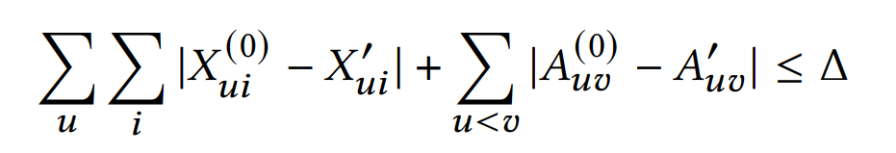
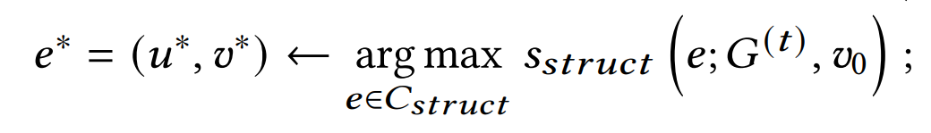
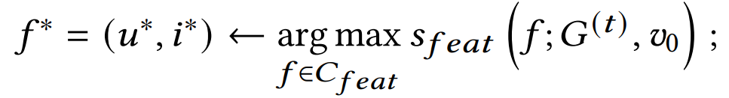
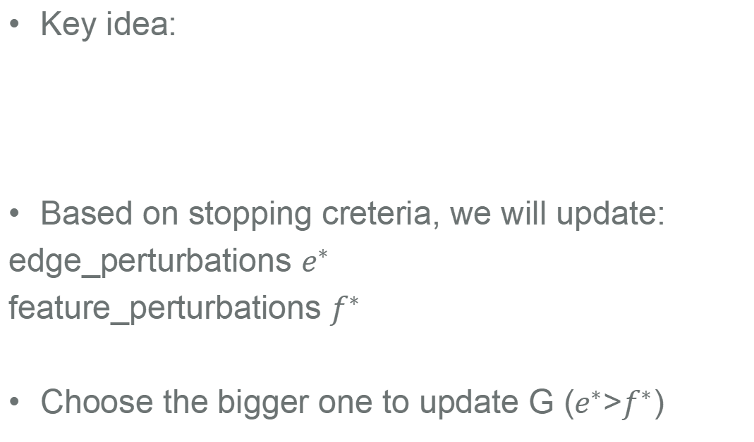
Net Attack -SOTA Baseline
Key idea:
Based on stopping creteria, we will update:
edge_perturbations $e^{∗}$
feature_perturbations $f^{∗}$
Choose the bigger one to update G ($e^{∗}$>$f^{∗}$)

Slide 27
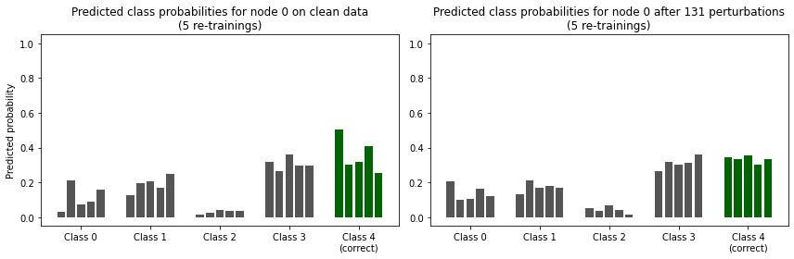
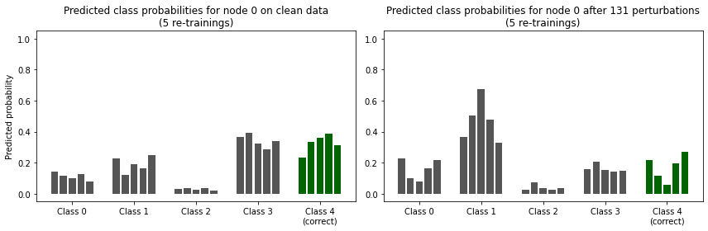
Net Attack
Only features
Both

Slide 28

Meta Attack- SOTA Baseline
Gradient Descent
Poisoning attack on graph neural networks with meta gradients and self-training
Poisoning attack on graph neural networks with approximate meta gradients and self-training

Slide 29
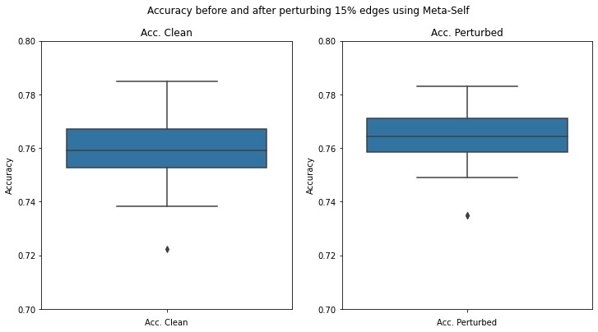
Meta Attack

Slide 30
Poisoning Attack
Net Attack! Failed
Meta Attack! Failed
We Only Attack Node
Embeddings!

Slide 31
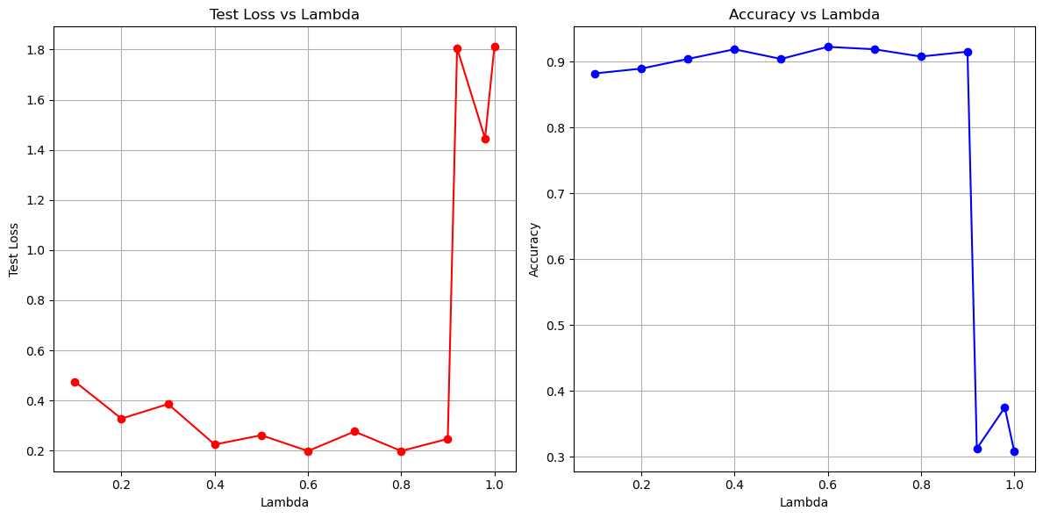
Poisoning Attack
λ-mean embeddings Cora result

Slide 32
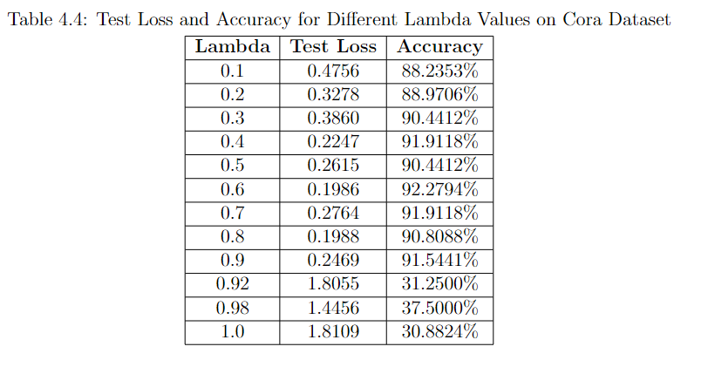
Poisoning Attack
λ-mean embeddings Cora result

Slide 33
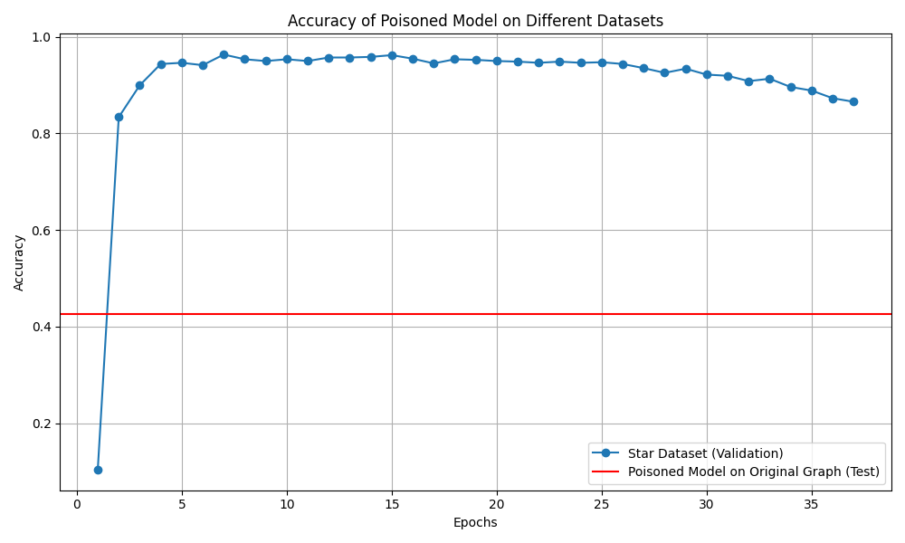
Poisoning Attack
Applying Graph Contrastive Learning to Poison Node Embeddings

Slide 34
Conclusion
This study introduced a state-of-art problem: attacking graph datasets with node embeddings derived from text data, a scenario particularly relevant to Social Network analysis and Citation Networks.
Our investigation encompassed both decision-time and poisoning attacks, paying more attention on the latter by strictly altering only node embeddings without simultaneously perturbing the graph structure and embeddings.

Slide 35
Constrains & Reflection
Only higher ε or λ values, might be necessary to achieve more pronounced adversarial impacts.
PGD >> Poisoning Attacks
Linkage contains information

Slide 36
Future Work
Backdoor Attacks for Graph Data
Textual Embedding Revision
Exploring Defensive Strategies

Slide 37
Acknowledgement
Advisor: Prof. Yevgeniy Vorobeychik
Committee Member: Prof. Nathan Jacobs, Prof. Ning Zhang
Lab Members: Michael Lanier, Anindya Sarkar, Junlin Wu, Andrew Estornell, Jinghan Yang, and Rajagopal Venkatasaramani
Special Thanks: Prof. Donsub Rim
...

Slide 38
Resource
Github repo: https://github.com/YingXu001/Attack_Graph

Slide 39
References
[1] T. Balaji, C. S. R. Annavarapu, and A. Bablani. Machine learning algorithms for social media analysis: A survey. Computer Science Review, 40:100395, 2021.
[2] B. Biggio and F. Roli. Wild patterns: Ten years after the rise of adversarial machine learning. In Pattern Recognition. Elsevier, 2018.
[3] C. M. Bishop. Pattern recognition and machine learning. 2006.
[4] J. Chen, Y. Wu, X. Xu, Y. Chen, H. Zheng, and Q. Xuan. Fast gradient attack on network embedding. arXiv preprint arXiv:1809.02797, 2018.
[5] H. Dai, H. Li, T. Tian, X. Huang, L. Wang, J. Zhu, and L. Song. Adversarial attack on graph structured data. In International conference on machine learning, pages 1115–1124. PMLR, 2018.
[6] J. Devlin, M. Chang, K. Lee, and K. Toutanova. BERT: pre-training of deep bidirectional transformers for language understanding. CoRR, abs/1810.04805, 2018.
[7] I. Goodfellow, J. Shlens, and C. Szegedy. Explaining and harnessing adversarial examples. In International Conference on Learning Representations, 2015.
[8] L. Huang, D. Ma, S. Li, X. Zhang, and H. Wang. Text level graph neural network for text classification. arXiv preprint arXiv:1910.02356, 2019.
[9] T. N. Kipf and M. Welling. Semi-supervised classification with graph convolutional networks. arXiv preprint arXiv:1609.02907, 2016.
[10] A. Madry, A. Makelov, L. Schmidt, D. Tsipras, and A. Vladu. Towards deep learning models resistant to adversarial attacks. In 6th International Conference on Learning Representations, ICLR 2018, Vancouver, BC, Canada, April 30 - May 3, 2018, Conference Track Proceedings, 2018.
[11] I. Portugal, P. Alencar, and D. Cowan. The use of machine learning algorithms in recommender systems: A systematic review. Expert Systems with Applications, 97:205–227, 2018.
[12] A. Radford, J. W. Kim, C. Hallacy, A. Ramesh, G. Goh, S. Agarwal, G. Sastry, A. Askell, P. Mishkin, J. Clark, et al. Learning transferable visual models from natural language supervision. In International conference on machine learning, pages 8748–8763. PMLR, 2021.

Slide 40
References
[13] Y. Sun, S. Wang, X. Tang, T.-Y. Hsieh, and V. Honavar. Adversarial attacks on graph neural networks via node injections: A hierarchical reinforcement learning approach. In Proceedings of the Web Conference 2020, pages 673–683, 2020.
[14] A. Vaswani, N. Shazeer, N. Parmar, J. Uszkoreit, L. Jones, A. N. Gomez, L. Kaiser, and I. Polosukhin. Attention is all you need. In Advances in neural information processing systems, pages 5998–6008, 2017.
[15] P. Veliˇckovi ́c, G. Cucurull, A. Casanova, A. Romero, P. Li`o, and Y. Bengio. Graph attention networks, 2018.
[16] Y. Vorobeychik and M. Kantarcioglu. Adversarial machine learning / Yevgeniy Vorobeychik, Murat Kantarcioglu. Synthesis lectures on artificial intelligence and machine learning, 38. Morgan Claypool, San Rafael, California, 2018.
[17] H. Wu, C. Wang, Y. Tyshetskiy, A. Docherty, K. Lu, and L. Zhu. Adversarial examples on graph data: Deep insights into attack and defense. arXiv preprint arXiv:1903.01610, 2019.
[18] Z. Wu, S. Pan, F. Chen, G. Long, C. Zhang, and P. S. Yu. A comprehensive survey on graph neural networks. IEEE Transactions on Neural Networks and Learning Systems, 2020.
[19] T. Young, D. Hazarika, S. Poria, and E. Cambria. Recent trends in deep learning based natural language processing. ieee Computational intelligenCe magazine, 13(3):55–75, 2018.
[20] R. Zellers, A. Holtzman, Y. Bisk, A. Farhadi, and Y. Choi. Hellaswag: Can a machine really finish your sentence? arXiv preprint arXiv:1905.07830, 2019.
[21] J. Zhou, G. Cui, S. Hu, Z. Zhang, C. Yang, Z. Liu, L. Wang, C. Li, and M. Sun. Graph neural networks: A review of methods and applications. AI open, 1:57–81, 2020.
[22] Y. Zhu, X. Ai, Y. Vorobeychik, and K. Zhou. Homophily-driven sanitation view for robust graph contrastive learning, 2023.

Slide 41
References
[23] D. Z ̈ugner, A. Akbarnejad, and S. G ̈unnemann. Adversarial attacks on neural networks for graph data. Proceedings of the 24th ACM SIGKDD International Conference on Knowledge Discovery & Data Mining, pages 2847–2856, 2018.
[24] D. Z ̈ugner and S. G ̈unnemann. Adversarial attacks on graph neural networks via meta learning. In International Conference on Learning Representations, 2019.

Slide 42
Thanks for listening.
Any Questions?

